Slide 1





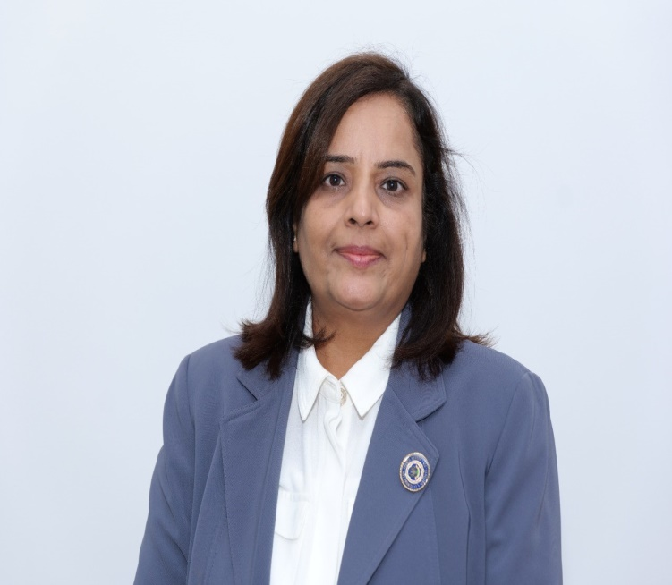
The Institute of Chartered Accountants of India
(Set up by an Act of Parliament)
Women Members Excellence Committee
Organises
यशस्विनी - An IDOL- Live Webinar
CA. Priti Paras Savla
Chairperson, WMEC, ICAI
CA. Kemisha Soni
Vice Chairperson, WMEC, ICAI

Slide 2

Using new age Technology in internal audit
Usha Lakshmi Raman

Slide 3
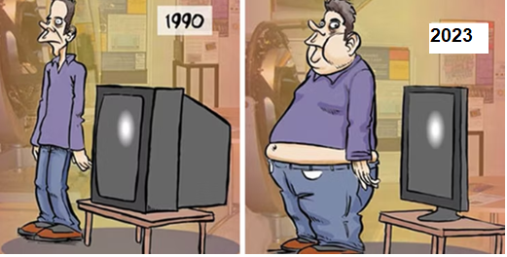
Slimmed- Down Tech ?
Chota Packet
Bada Dhamaka!!
2024

Slide 4

Paradigm Shift
Disruption in external environment
Increased Regulatory changes
Adoption of digital systems
Complexity of business

Slide 5
Metamorphosis – Video clip
Interview of Lisa Lee of Google by
Richard Chambers – Senior Internal Auditor – Audit Board
Author of books relevant to us like Agents of Change, Speed of Risk

Slide 6
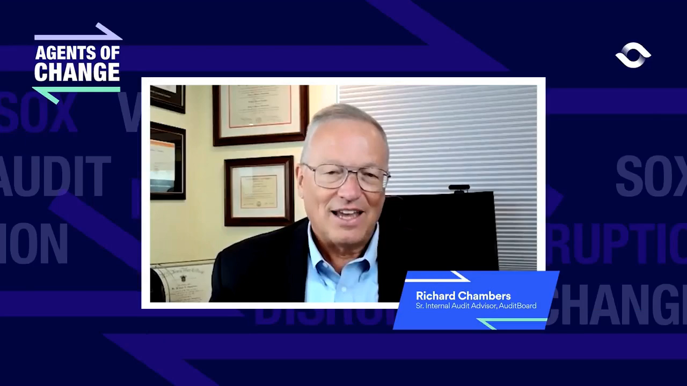

Slide 7

Metamorphosis
Watch Dog to Change Agent/ Value creators
Compliance & controls-based player to a Strategic partner
Traditional Audit to Technology Based Audit
Akin to a Butterfly- One form fades to give rise to the new form

Slide 8

In
As per the 2022 Pulse Report, Chief Audit Executives were asked to consider how they would prioritize additional funds for technology.
Let us see which technology was prioritised
  68% Data Analytics
  54% Audit Management
  34% Robotic Process Automation
  31% Artificial Intelligence
Internal Audit driven by innovation and automation has emerged as the biggest “Sunrise area”

Slide 9

Opportunities of Technology in
Audit Function - Data aNALYTICS
Tools - Power BI, Tableau, Qlik Sense, Python, SQL or Macros
FUNCTIONS
Analyse large volumes of data
  Identifies Patterns/ Aberrations
  Provides insights to Management
  Detects Risks
  Continuous Monitoring
  FROM
  Sampling-based audit to audit 100% of the universe
  Random Sampling to Strategic Sampling
  From Transaction audit to Process Audit
  From Periodic to Real-time Audit

Slide 10

Opportunities of Technology in Audit Function
Audit Management Tool
Creation of an audit plan
  Project Management – Create audit schedules, allocate resources, and establish timelines for conducting audits.
  Document Management- Repository of audit-related documents
  Reporting – Now with open AI like Chat GPT, and Google Bard, even audit reports can be written. At least the English is taken care
  Track open issues and send periodic emails through system/applications

Slide 11

Opportunities of Technology in Audit Function
Cyber Security
Security Operations Center – SOC
Data loss prevention software – DLP
Vulnerability Assessment and Penetration Testing (VAPT)
Identity and Access Management (IDAM) Solution
Mobile Device management
Encryption Tools
Antivirus Software
Firewall Tools
Ransomware Attacks

Slide 12
Opportunities of Technology in Audit Function
AI & Machine Learning
These Technologies help banks and financial institutions to analyze large amounts of customer data
  Anomalies or aberration
  Fraudulent activities
  Personalised services
  Biometric Verification: Facial recognition and fingerprint scanning help customer identity. E.g Aadhar
  API Integration:
  Log in using Facebook/Twitter/Google Functionality
  Aggregation of data by Cleartrip, Zomato, etc.
  Payment with a Credit card, PayTM

Slide 13

Use of AI in IA – Chat GPT
Give important checkpoints in the audit of the redemption process of mutual fund
  Review the mutual fund's redemption policies and procedures to ensure they comply with regulatory requirements.
  Assess the adequacy of internal controls in place to mitigate the risk of errors or fraud in the redemption process.
  Verify that redemptions are authorized by the appropriate parties, such as the investor or their authorized representative.
  Check for proper documentation, including redemption requests
  Validate the accuracy of redemption calculations, including NAV
  Confirm compliance with AML and KYC regulations by reviewing investor identification and verification procedures.
  Review of Exceptions and Unusual Transactions:

Slide 14
Use of AI in IA – Chat GPT
Give important checkpoints in the audit of the purchase of fixed assets in a company
  Verify that the purchase of fixed assets is authorized by appropriate individuals
  Verify that all fixed asset purchases are accurately recorded in the accounting system.
  Review purchase orders with invoices, and contracts to ensure completeness and accuracy of recorded amounts.
  Ensure that fixed assets are correctly classified as per accounting standards (property, plant & equipment categories)
  Assess whether the valuation of fixed assets is reasonable and in accordance with accounting principles (e.g., historical cost, fair value)
  Physical Inspection
  Verify that the company has legal ownership rights to the purchased fixed assets.
  Ensure compliance with the company's capitalization policy
  Assess the appropriateness and accuracy of the depreciation and amortization
  Evaluate the effectiveness of internal controls over the purchase of fixed assets, including segregation of duties, approval processes, and documentation requirements
  Examine contracts or agreements related to fixed asset purchases. Assess for related party transactions

Slide 15

Opportunities of Technology in Audit Function
Perturbed?

Slide 16
Video clip 2
Interview of Lisa Lee of Google by
Richard Chambers – Senior Internal Auditor – Audit Board Author of books relevant to us like Agents of Change, Speed of Risk

Slide 17
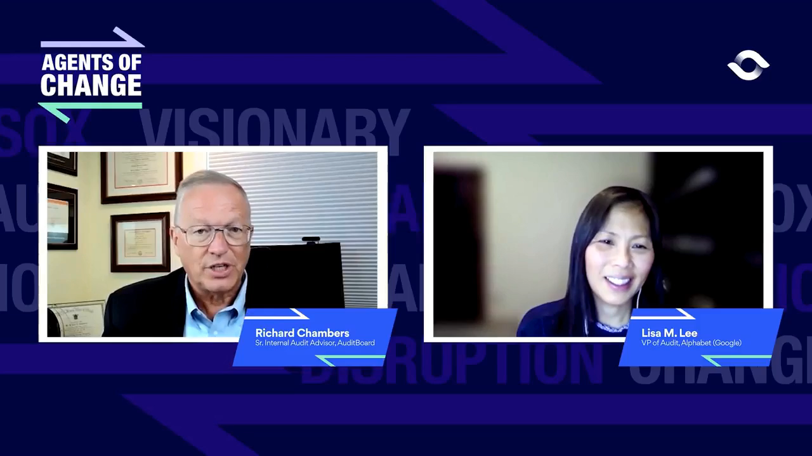

Slide 18

Embrace Technology
Thank you!

